Slide 1

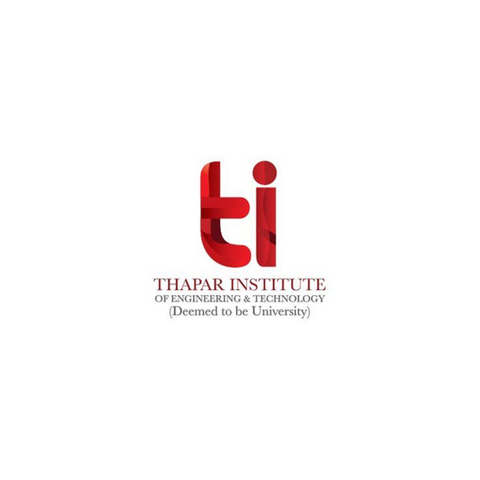


ML (UML510)
Final Project Presentation
AGRIBOT
Mentor- Dr. Sanjeev Rao
Submitted By-
Gurleen Kaur (102203197)
Simrat Kaur (102203201)

Slide 2
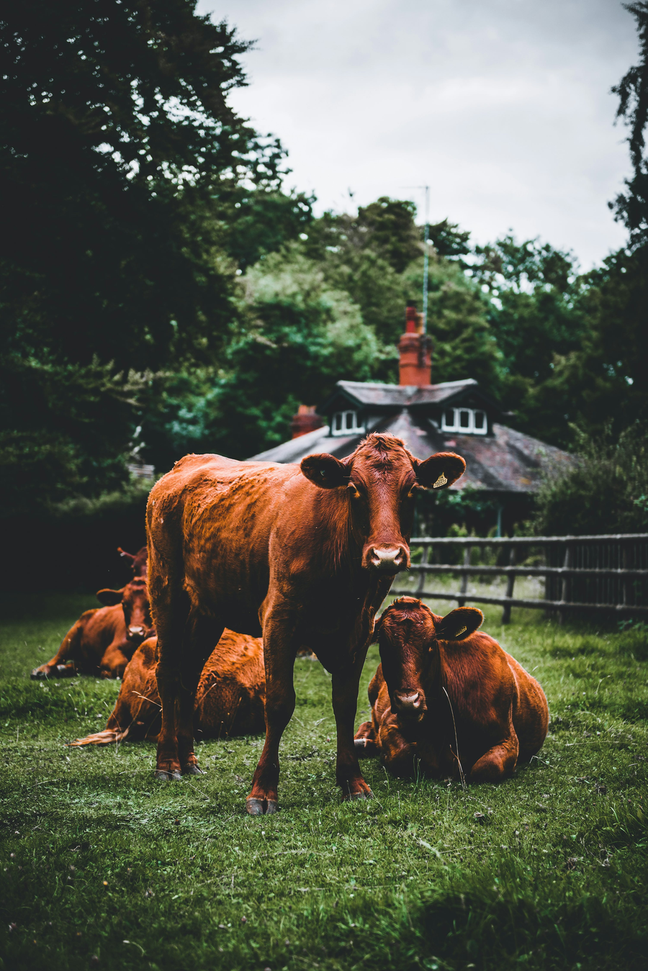
Content
01
Problem Statement
02
Flow Diagram
03
Methodology
04
Evaluation Parameters
05
Challenges Faced
06
Conclusion
07
References

Slide 3






Problem Statement
AgriBot is a multilingual chatbot empowering Indian farmers with instant agricultural information in Hindi, English, and Punjabi. It addresses language barriers, offering guidance on crop management, pest control, weather, government schemes, and market prices, making vital resources accessible and impactful for farmers across India.
AgriBot

Slide 4

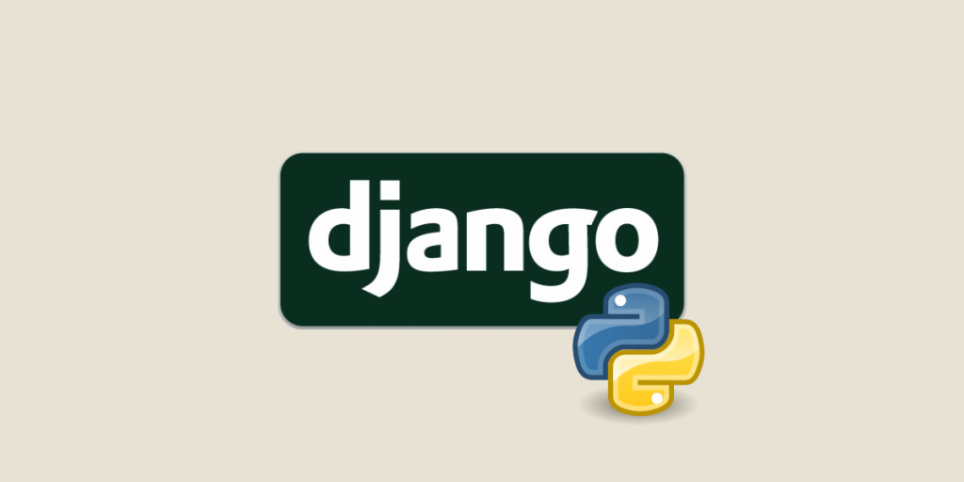
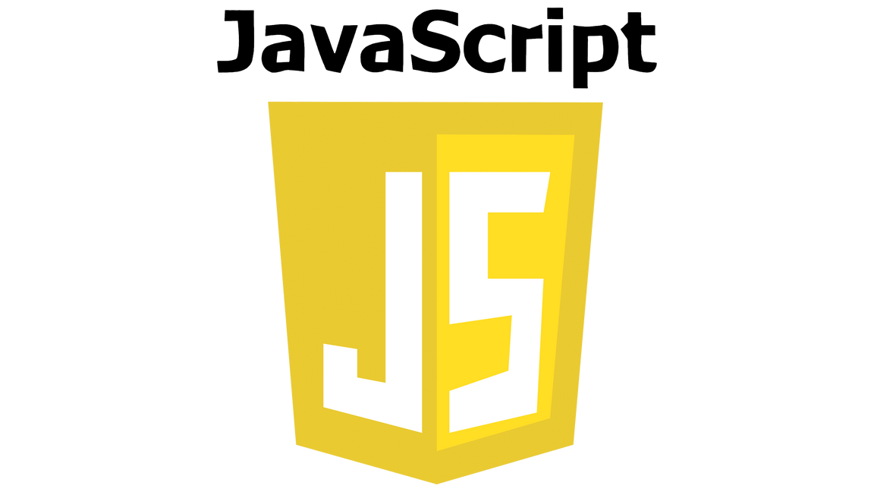
Programming
Languages Used
01
Python/ Django (backend + ML Model training)
02
Java Script (translations file)
03
HTML , CSS (frontend)

Slide 5

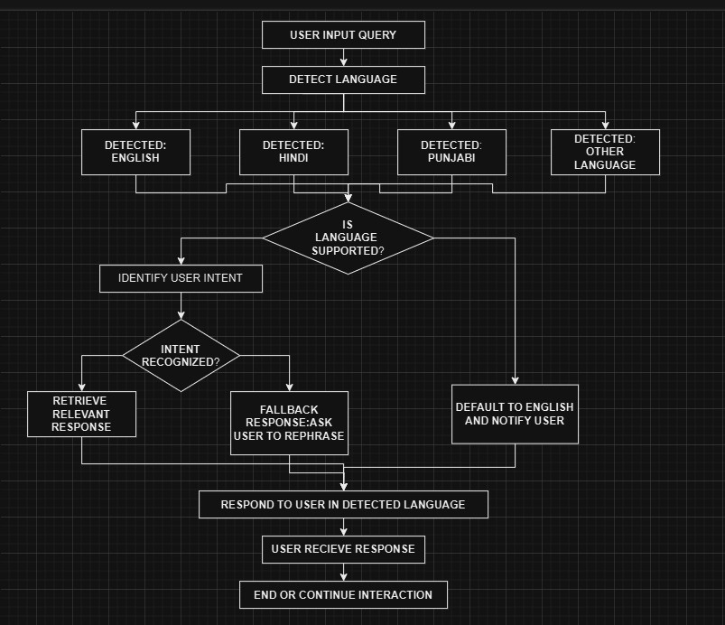
FLOW DIAGRAM

Slide 6

Methodology
Data Loading and Parsing
01
AgriBot is a multilingual chatbot designed to empower Indian farmers by providing instant, reliable agricultural information in Hindi, English, and Punjabi.AgriBot seeks to bridge the knowledge gap in agriculture, making essential information more accessible and impactful for farmers across India.
Load a dataset from a JSONL file where each line contains a question-answer pair for agricultural queries. Parse these entries to create lists of questions and answers.
Translation: Use the Google Translate API to translate questions and answers from English into Hindi and Punjabi. This enhances the chatbot's multilingual capability, allowing responses in languages commonly spoken in agricultural communities.
Language Detection
02
Implement a script-based language detection function using regular expressions to determine if the user's query is in English, Hindi, or Punjabi. This ensures that responses match the language of the query.

Slide 7

Text Normalization
and Matching
03
Normalize user queries and questions by converting to lowercase and removing special characters,enabling more effective string matching.
Question Matching
and Response Retrieval
04
Response
Delivery
Use a word-overlap matching algorithm to find the best-matching question in the dataset. This involves calculating the intersection of words between the user's query and each question in the dataset, selecting the question with the most overlap.
05
Return the answer associated with the closest matching question in the user's detected language. If no good match is found, return a default response asking for clarification.

Slide 8

Integrating Neural Machine Translation (NMT) with NLP for Multilingual Applications
What is Natural Language Processing (NLP)?
NLP involves the interaction between computers and human languages.
Core tasks include language translation, sentiment analysis, text generation, and summarization.
It enables machines to understand, process, and generate human language.
Neural Machine Translation (NMT): A Key NLP Application
NMT uses deep learning models, particularly the transformer architecture, for language translation.
Incorporates an attention mechanism to focus on relevant parts of the input for context preservation.
Ensures translations maintain grammatical structure, semantics, and cultural nuances.

Slide 9
Integrating Neural Machine Translation (NMT) with NLP for Multilingual Applications
Google Translate and the Code Implementation
The code leverages the googletrans library, an interface to Google Translate's pre-trained NMT models.
Powered by advanced NMT technology, the system ensures high-quality, context-aware translations.
Translation Tasks Performed:
Source Language: English
Target Languages: Hindi (hi), Punjabi (pa)
Benefits of Using NMT Models
Context preservation with the attention mechanism.
Scalability for handling multiple languages.
Pre-trained models reduce the need for large-scale data collection and training.

Slide 10
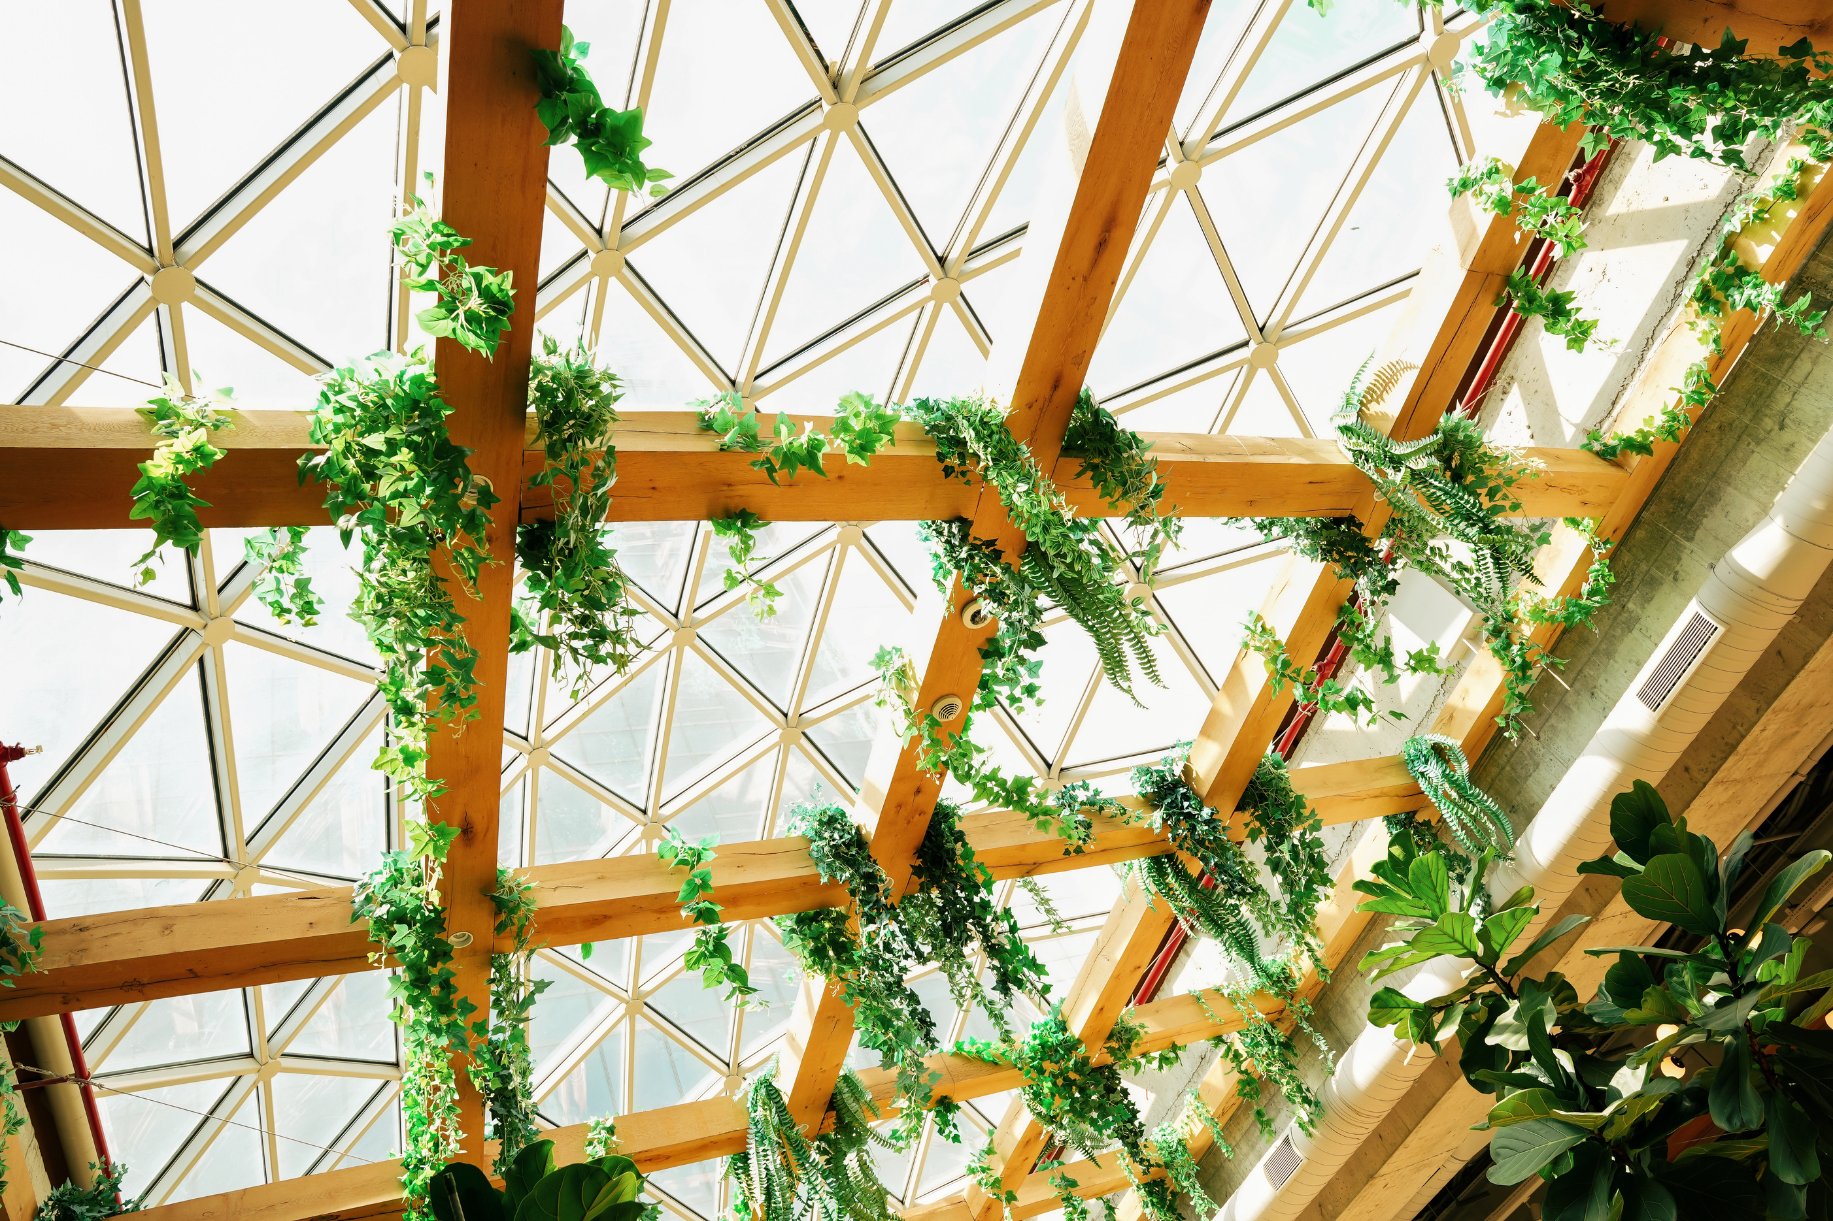
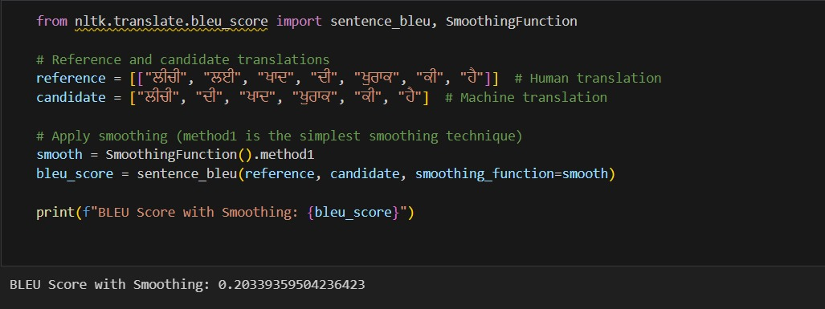
EVALUATION
PARAMETERS
1. BLEU Score (Billingual Evaluation Understudy)
BLEU measures how closely a machine-translated text matches reference translations.
STEPS-
Collect reference translations: Ideally, human-translated versions of the same text in target languages (Hindi, Punjabi).
Compare the machine translations (from Google Translate) with these reference translations.

Slide 11
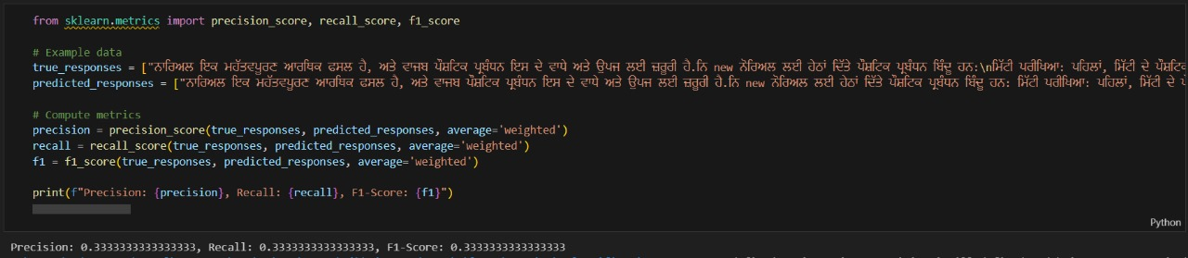
EVALUATION
PARAMETERS
2. Performance Metrics
1.Precision
2.Recall
3.F1-Score

Slide 12
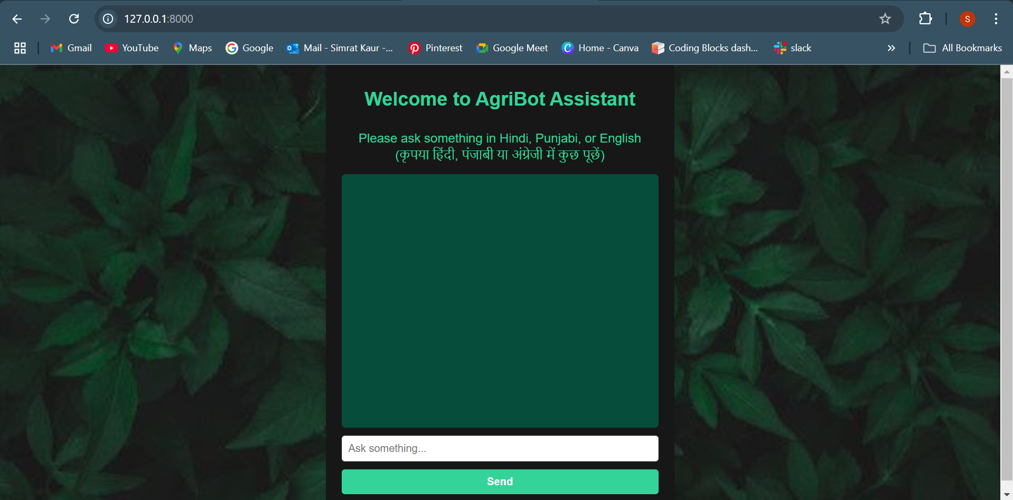
Django App Screenshots

Slide 13
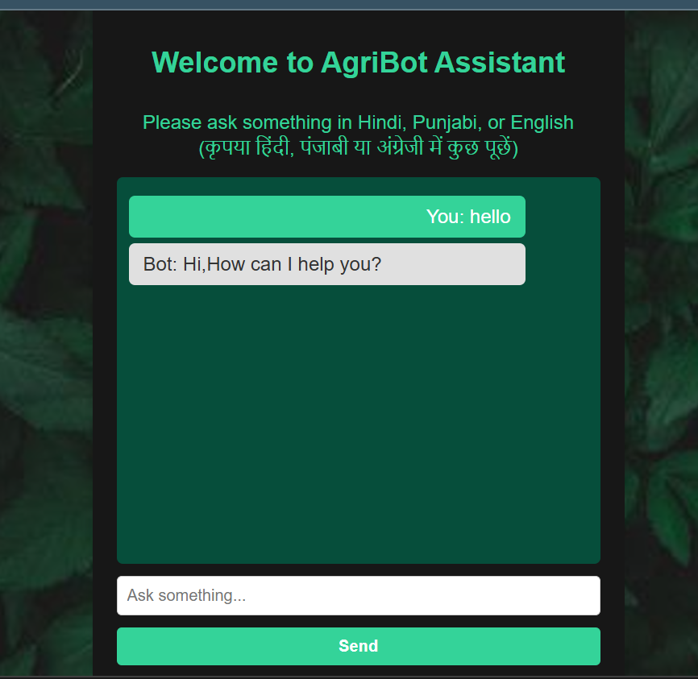
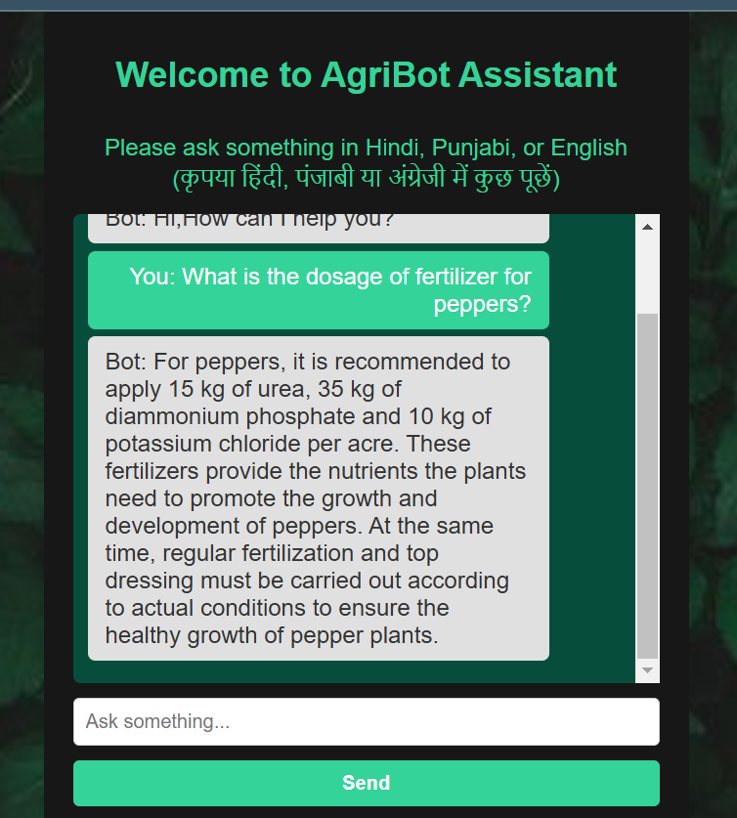
English Prompt

Slide 14
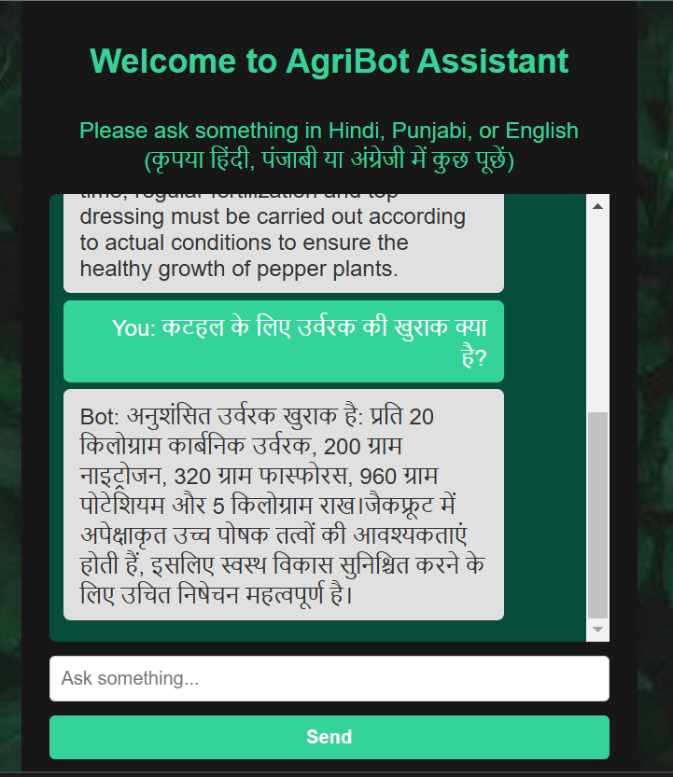
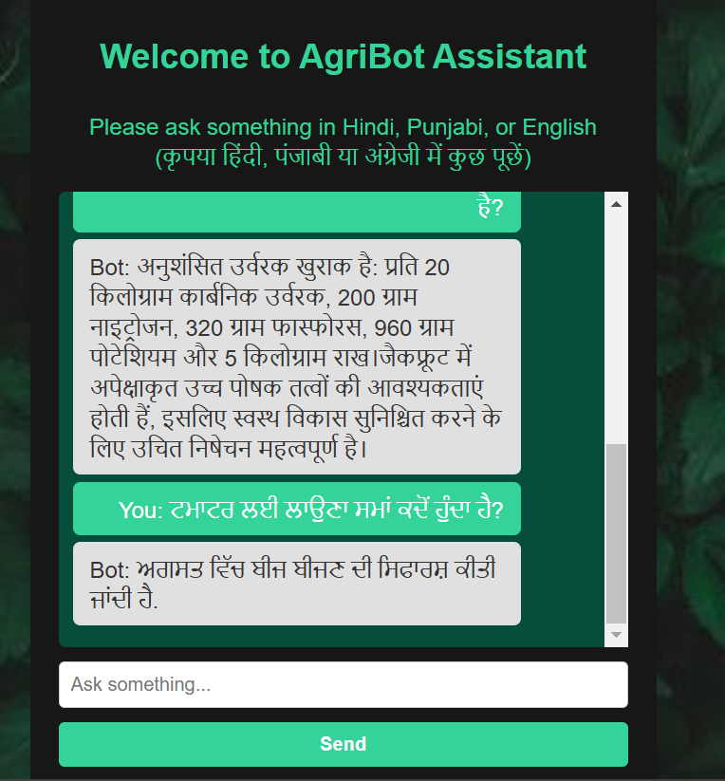
Hindi Prompt
Punjabi Prompt

Slide 15



Challenges
Initially, we attempted to train a custom model for multilingual translation and query understanding using the following libraries and tools:
SentenceTransformer:
Used to generate embeddings for textual data.
Challenge: Limited performance for multilingual translations, as the model struggled with semantic nuances across diverse languages like Hindi and Punjabi.
GoogleTrans (Translation):
Integrated for language translation, but was initially insufficient for handling domain-specific terminologies in agriculture-related queries.
LangDetect:
Utilized for language detection.
Challenge: It occasionally produced incorrect language predictions for short or ambiguous inputs, leading to misinterpretations.
Cosine Similarity (Text Matching):
Explored for retrieving the most relevant responses by comparing embeddings.
Challenge: Required a large dataset of high-quality embeddings, which was computationally expensive and less scalable for multiple languages.

Slide 16
Challenges
Why Training the Model Failed?
Dataset Limitations: Lack of domain-specific multilingual datasets hindered accurate training.
Resource Constraints: Training deep learning models for translation and semantic understanding demands extensive computational resources and time.
Complexity of Multilingual Understanding: Capturing nuances, grammar, and cultural context in translations across English, Hindi, and Punjabi proved challenging for the custom model.
Resolution
We opted to leverage Google Translate's pre-trained NMT models instead, as they are highly optimized for multilingual translation tasks. By integrating these advanced models, we ensured efficient, accurate, and context-aware translations without the need for extensive training.

Slide 17
CONCLUSION
This project successfully demonstrates the integration of Neural Machine Translation (NMT) with Natural Language Processing (NLP) to develop a multilingual system capable of handling English, Hindi, and Punjabi queries. By leveraging pre-trained models like Google Translate, we achieved efficient, context-aware translations without the need for resource-intensive training.
Future Scope
Domain-Specific Enhancements: Develop or fine-tune models tailored to agriculture-related queries for improved accuracy.
Voice to Text recognition: Add voice to text recognition in our chatbot.
Feedback Learning: Implement user feedback mechanisms for continuous improvement in translation quality and response relevance.

Slide 18
References
01
https://ieeexplore.ieee.org/document/10276356:
An AgroBot: Natural Language Processing Based Chatbot for Farmers Publisher: IEEE
02
https://universalcollegeofengineering.edu.in/wp-content/uploads/2024/03/9-2.pdf:
Agrobot: NLP based Image and Text Query Chatbot
https://ieeexplore.ieee.org/abstract/document/10306512
Agriculture Chatbot(AGRIBOT)Using Natural Language Processing
03
04
https://d1wqtxts1xzle7.cloudfront.net/90575477/IRJET_V9I4393-libre.pdf?1662133270

Slide 19
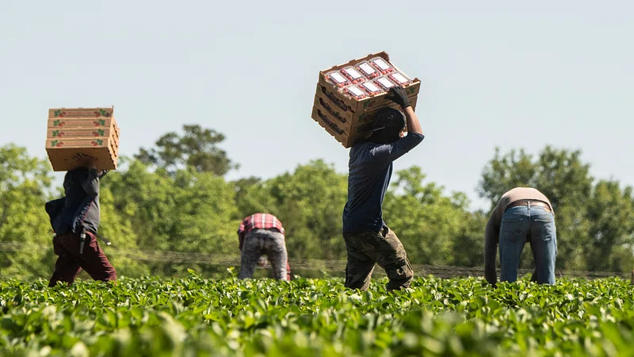
THANK YOU!!!

